Slide 1


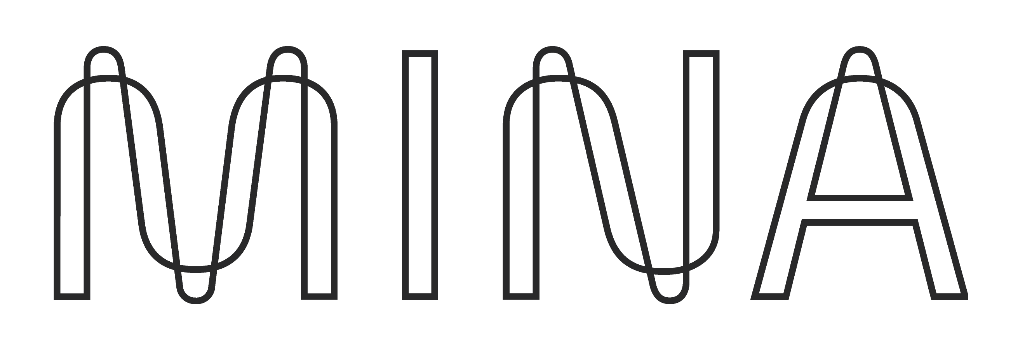
Naamah Mina Stake
THE MOST CONCISE PROOF OF EVERYTHING BLOCKCHAIN

Slide 2
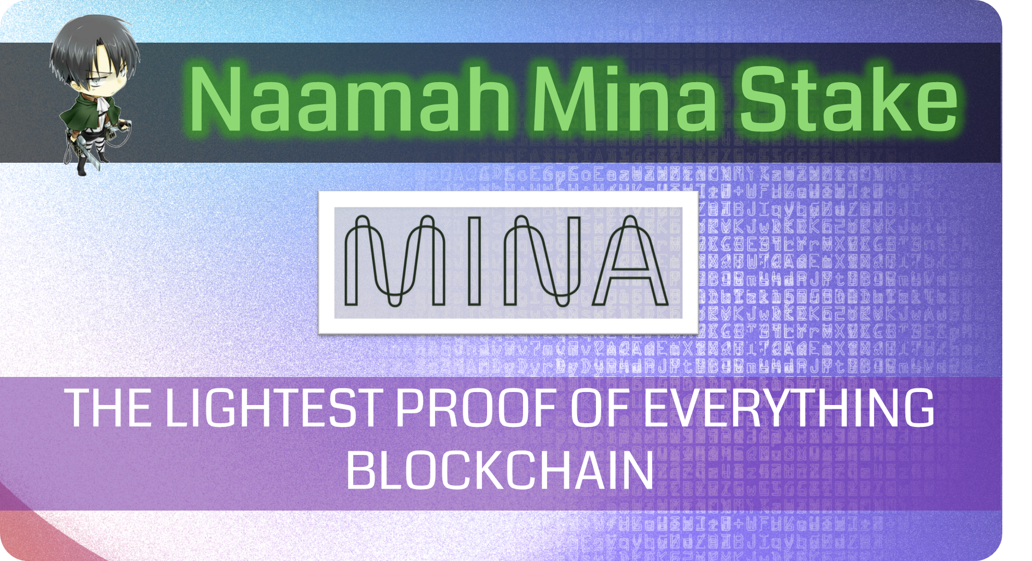

Slide 3
